Slide 1
Introduction to Simulation

Slide 2
Contents
Introduction
Coins and Dice
Queuing and Definitions

Slide 3
Blank Slide

Slide 4
Introduction

Slide 5
Approaches
There are three “approaches” covered:
By hand to gain understanding of the process
Using Excel useful for small problems
Using Python to code simulations, note you can use any other programming language

Slide 6
Stages in an Investigation
How to construct a simulation
Design of experiments
Analysis of results from the simulation

Slide 7
Simulating Systems
Simulation techniques are used to enable the analysis of complex problems. Football fans, name a famous simulation?
Within Operational Research these problems often involve queuing applications
Questions to be answered:
“can the current service system process the expected demand in a reasonable time?”
“will the proposed new machinery improve (reduce) flow time or costs?”

Slide 8
Why Simulate?
In most organisations it is not a feasible option that the firm carries out a full reorganisation (of its factory or sites of their factories)
Simulation is cheap and can model complex interactions
Allows prediction of future situations that have yet to occur
Therefore, a firm can predict whether reorganisations are beneficial

Slide 9
Example
Considering a factory workshop the management might want to investigate
Staffing levels, what is an ideal number and type of staff
How many machines to use at each stage in the production process
Should they use production lines
What is an appropriate delivery/production time quotation (to a customer)

Slide 10
Evaluating Alternatives
When carrying out a Simulation there need to be some established criteria (to be able to evaluate alternatives)
Objective – e.g. would a new machine reduce costs and or improve performance
Cost – e.g. Reduced cost through correct staffing or better machines – offset against investment needed for change
Time – e.g. Reduced production time
Time – e.g. Improved throughput, i.e. work in progress (including rework)

Slide 11
The Heated Clothes Rack

Slide 12
Coins and Dice

Slide 13
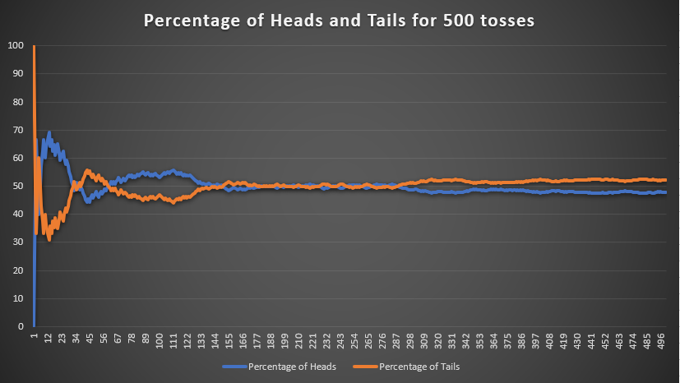
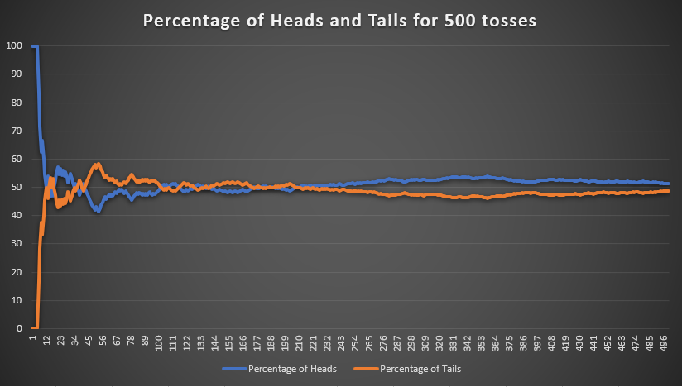
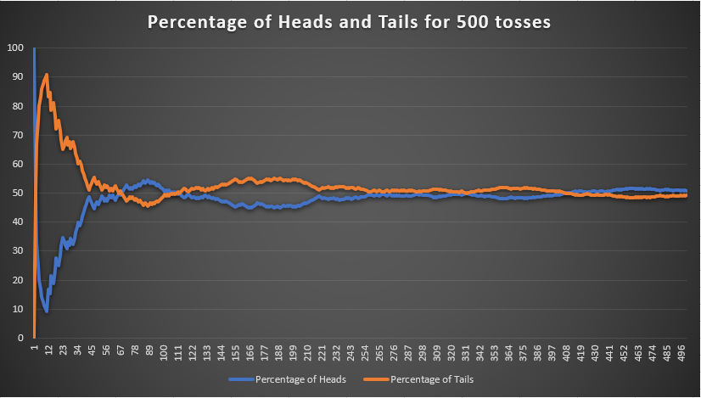
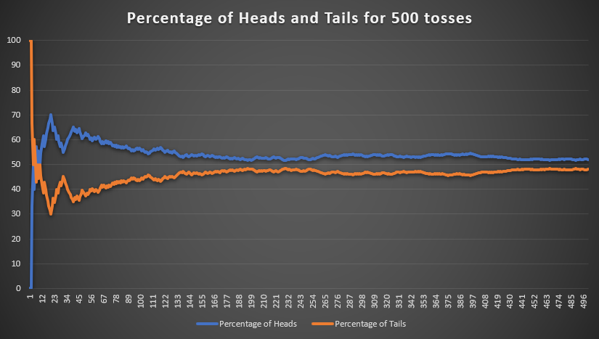
Simulating a Fair Coin Toss
Excel has been used to randomly simulate 500 trial tosses of a fair coin. 4 simulation runs are shown.
In the long run we get roughly 50% heads. This is the law of large numbers at work.

Slide 14
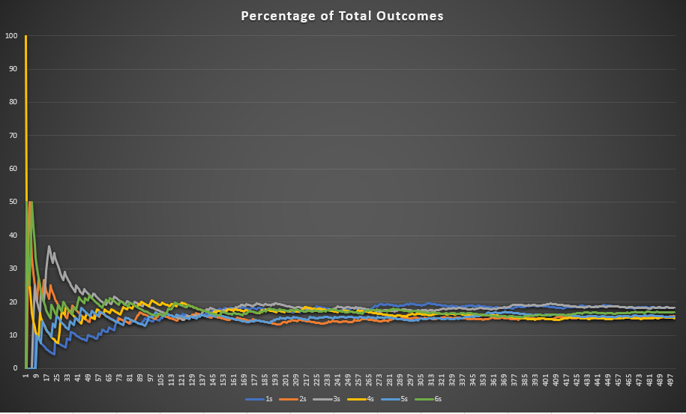
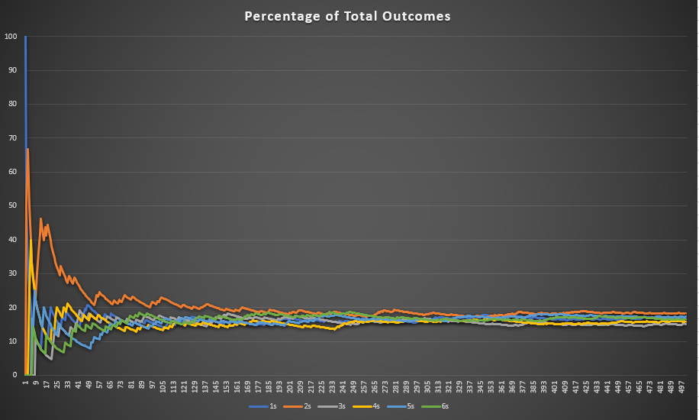
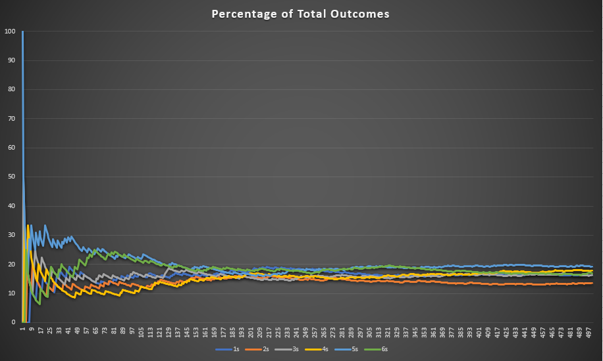
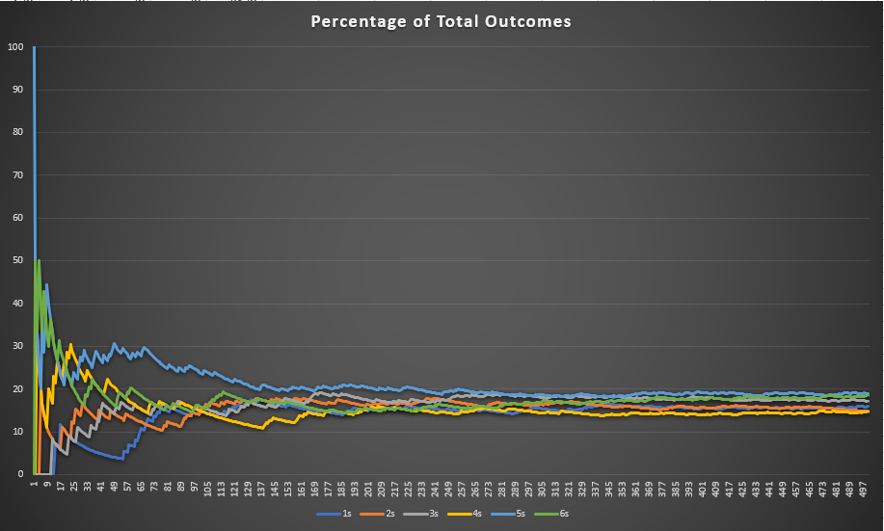
Simulating a Fair 6-Sided Dice
Excel has been used to randomly simulate the rolling of 6-sided dice for 500 trials. The 4 simulations are shown.
In the long run we get roughly 16.67% of each number. This is the law of large numbers at work.

Slide 15
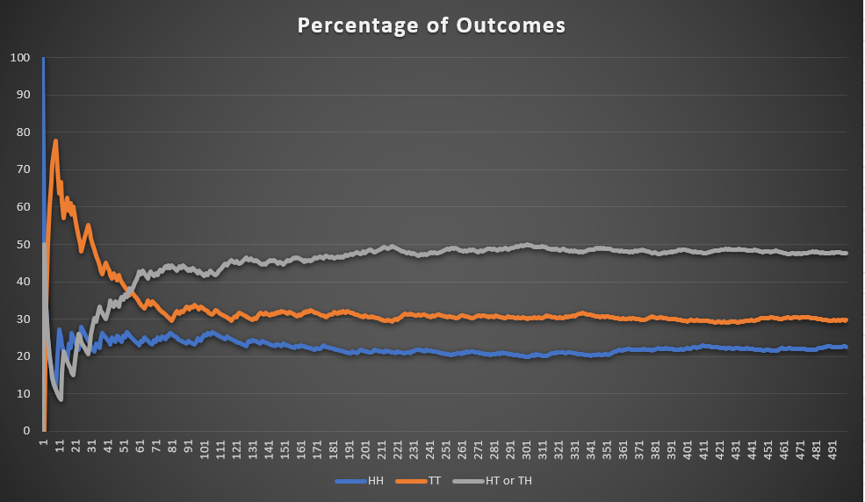
Simulating Two Fair Coin Tosses
Excel has been used to randomly simulate 500 trials of 2 coin tosses of a fair coin.

Slide 16
Queuing and Definitions

Slide 17

Queueing System
Customers queueing for a service, note this could be jobs waiting for a machine!
Queue
Service
What are the unknowns?

Slide 18
Queueing System
Queue
Service
Arrival Process
Queue Characteristics
Service Mechanism

Slide 19
Arrival Process
Queue
Service
how customers arrive e.g. singly or in groups (batch or bulk arrivals)
how the arrivals are distributed in time (e.g. what is the probability distribution of time between successive arrivals (the inter-arrival time distribution)
whether there is a finite population of customers or (effectively) an infinite number

Slide 20
Queue Characteristics
Queue
Service
how, from the set of customers waiting for service, do we choose the one to be served next (e.g. FIFO (first-in first-out) also known as FCFS (first-come first served); LIFO (last-in first-out); randomly) (this is often called the queue discipline)
do we have:
  balking (customers deciding not to join the queue if it is too long)
  reneging (customers leave the queue if they have waited too long for service)
  jockeying (customers switch between queues if they think they will get served faster by so doing)
  a queue of finite capacity or (effectively) of infinite capacity

Slide 21
Service Mechanism
Queue
Service
a description of the resources needed for service to begin
how long the service will take (the service time distribution)
the number of servers available
whether the servers are in series (each server has a separate queue) or in parallel (one queue for all servers)
whether pre-emption is allowed (a server can stop processing a customer to deal with another "emergency" customer)

Slide 22
Definitions
Queue
Service
Queuing process consists of customers arriving at a facility, waiting in a line (queue) if all servers are busy, receiving service, and departing.
Queueing system is a set of customers, a set of servers, and an order whereby customers arrive and are processed.
Inter-arrival time (IAT) is the time between successive customer arrivals to the service facility.
Batch Sizes: Number of items that “travel together” through a stage within the production system
Service time the time required by one server to serve one customer.

Slide 23
Assumptions (initial)
Standard assumptions are:
All customers arrive singly
Customers do not leave a queue once they have joined it (no reneging)
Arriving customers do not refuse to enter a queue for any reason. (balking)
One server can completely serve one customer

Slide 24
What can be simulated?
Queue
Service
From the simple queueing process, we can chain these together in different configurations
Queue
Service
Service
Service
Service
Service
Queue
Service
Service
Queue
Queue
Service
Service
Service

Slide 25
Example – Doctor’s Waiting Room
We’ve already seen the simple example. This is commonly referred to as the Doctor’s waiting room
Queue
Service

Slide 26

Example – Traffic Lights
What are the best light settings?
The aim of the simulation could be the determination of these settings.
Traffic Lights
Traffic Flow

Slide 27
Doctor’s Waiting Room
Queue
Service
Here uncertainty in the system is caused by the variability in:
Time between successive arrivals (inter-arrival time), and
Time to serve a customer (service time).

Slide 28
Operating a Simulation

Slide 29
Operating a Simulation
Queue
Service
To be able to represent an application, for example the doctor’s waiting room (small shop), the following data needs to be defined:
Arrival pattern/Arrival times
Service rate/Service time
To illustrate the process assume that the first five jobs arrive at times
3, 8, 13, 19, 22
and that their respective service times are
4, 7, 3, 9, 11

Slide 30
Operating a Simulation
Queue
Service
These values can be combined to carry out the simulation of this process to determine the simulation Metrics
waiting time (customer)
unused time (staff)
The “simulation” using these values is shown in the table on the next slide
Values in black were given and those in red have been calculated

Slide 31
Operating a Simulation
Queue
Service
Customer/Job Arrives | Service Starts | Service Duration | Service Ends | Customer/Job Waiting Time | Service Waiting Time
3 |  | 4
8 |  | 7
13 |  | 3
19 |  | 9
22 |  | 11

Slide 32
Operating a Simulation
Queue
Service
Customer/Job Arrives | Service Starts | Service Duration | Service Ends | Customer/Job Waiting Time | Service Waiting Time
3 | 3 | 4 | 3+4=7 | 3-3=0 | 3
8 |  | 7
13 |  | 3
19 |  | 9
22 |  | 11

Slide 33
Operating a Simulation
Queue
Service
Customer/Job Arrives | Service Starts | Service Duration | Service Ends | Customer/Job Waiting Time | Service Waiting Time
3 | 3 | 4 | 7 | 0 | 3
8 | max(8,7) = 8 | 7
13 |  | 3
19 |  | 9
22 |  | 11

Slide 34
Operating a Simulation
Queue
Service
Customer/Job Arrives | Service Starts | Service Duration | Service Ends | Customer/Job Waiting Time | Service Waiting Time
3 | 3 | 4 | 7 | 0 | 3
8 | 8 | 7 | 8+7=15
13 |  | 3
19 |  | 9
22 |  | 11

Slide 35
Operating a Simulation
Queue
Service
Customer/Job Arrives | Service Starts | Service Duration | Service Ends | Customer/Job Waiting Time | Service Waiting Time
3 | 3 | 4 | 7 | 0 | 3
8 | 8 | 7 | 15 | 8-8=0
13 |  | 3
19 |  | 9
22 |  | 11

Slide 36
Operating a Simulation
Queue
Service
Customer/Job Arrives | Service Starts | Service Duration | Service Ends | Customer/Job Waiting Time | Service Waiting Time
3 | 3 | 4 | 7 | 0 | 3
8 | 8 | 7 | 15 | 0 | 8-7=1
13 |  | 3
19 |  | 9
22 |  | 11
Have a go at completing this table by hand. Solution on next slide

Slide 37
Operating a Simulation
Queue
Service
Customer/Job Arrives | Service Starts | Service Duration | Service Ends | Customer/Job Waiting Time | Service Waiting Time
3 | 3 | 4 | 7 | 0 | 3
8 | 8 | 7 | 15 | 0 | 1
13 | 15 | 3 | 18 | 2 | 0
19 | 19 | 9 | 28 | 0 | 1
22 | 28 | 11 | 39 | 6 | 0

Slide 38
Simple Example

Slide 39
Operating a Simulation
This example uses
4 arrival times and their probability of occurrence
7 service duration times and their probability of occurrence
Inter-arrival Time | 8 | 12 | 16 | 20
Probability | 0.2 | 0.4 | 0.2 | 0.2
Service Duration | 7 | 11 | 15 | 18 | 20 | 22 | 24
Probability | 0.3 | 0.2 | 0.1 | 0.15 | 0.15 | 0.05 | 0.05
Queue
Service
Inter-arrival Time | 8 | 12 | 16 | 20
Cumulative Probability | 0-0.2 | 0.2-0.4 | 0.6-0.8 | 0.8-1
Service Duration | 7 | 11 | 15 | 18 | 20 | 22 | 24
Cumulative Probability | 0-0.3 | 0.3-0.5 | 0.5-0.6 | 0.6-0.75 | 0.75-0.9 | 0.9-0.95 | 0.95-1
We can use the cumulative probability and randomly generate a number between 0 and 1 to pick a time for a customer and similarly generate their service time.

Slide 40
Operating a Simulation
Inter-arrival Time | Service Duration
20 | 7
12 | 24
12 | 11
20 | 22
16 | 11
8 | 18
16 | 18
12 | 11
12 | 20
8 | 11
8 | 7
16 | 7
12 | 7
12 | 18
16 | 18
Customer Arrival Time | Service Starts | Service Duration | Service Ends | Customer Waiting Time | Service Waiting Time
20 | 20 | 7 | 27 | 0 | 20
32 | 32 | 24 | 56 | 0 | 5
44 | 56 | 11 | 67 | 12 | 0
64 | 67 | 22 | 89 | 3 | 0
80 | 89 | 11 | 100 | 9 | 0
88 | 100 | 18 | 118 | 12 | 0
104 | 118 | 18 | 136 | 14 | 0
116 | 136 | 11 | 147 | 20 | 0
128 | 147 | 20 | 167 | 19 | 0
136 | 167 | 11 | 178 | 31 | 0
144 | 178 | 7 | 185 | 34 | 0
160 | 185 | 7 | 192 | 25 | 0
172 | 192 | 7 | 199 | 20 | 0
184 | 199 | 18 | 217 | 15 | 0
200 | 217 | 18 | 235 | 17 | 0
208 | 235 | 20 | 255 | 27 | 0
220 | 255 | 7 | 262 | 35 | 0
240 | 262 | 7 | 269 | 22 | 0
256 | 269 | 15 | 284 | 13 | 0
268 | 284 | 7 | 291 | 16 | 0
Note with different inter-arrival times and service durations the waiting patterns would differ.

Slide 41
Basic Tips
Because a simulation is using randomness (stochasticity), it’s behaviour need time to settle down. Think law of large numbers, flipping a coin.
Run a simulation for a long enough time to be sure that the pattern you see isn’t a fluke!
Change some of your numbers to extremes and check that the simulation behaves reasonably.
  E.g. Make the service time very large, we expect a queue to form for the customers

